Slide 1

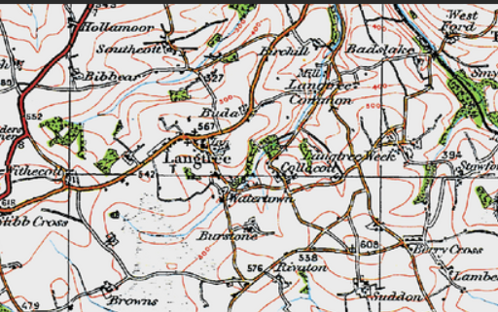


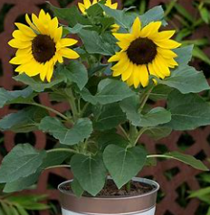

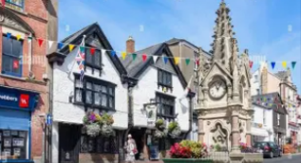




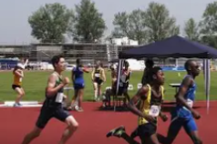
Curriculum Map – Oak Class – Summer 2026
Topic/Geography
Summer 1
English
R.E
What is the good news Christians believe God brings?
We will read a range of books including The Tiny Seed
Reception will continue to learn how to blend sounds to make words and say sentences that they have created.
Year 1 will write simple sentences and edit their own writing.
Local Map work
-Exploring places near school
-Looking at the location of school on a map
-Recognise simple map symbols related to the local area
Maths
Reception
Develop understanding of numbers to 10 –count confidently. Recognise numbers.
Shape – recognise and name common 2d shapes.
Capacity – recognise different amounts.
Using and tens frames to organize counting
Begin to identify bonds to 10.
Idenitfy Odd and Even numbers
Y1
Place value for numbers to 20
,Representing 2 - digit numbers using manipulatives and visuals.
Finding 1 more and 1 less.
Add and subtract number to 20.
Solving problems using money,
measure, addition and subtraction.
History – Summer 1
How did Torrington help win the English civil war?
Outdoor learning
Exploring how things grow
Investigating plants and flowers
Science
Plants
Identify different plants
Identify the different parts of a plant
Understand simple differences between plants
Understand what plants need to grow strong and healthy
Understand how seeds and bulbs grow
Idenitfy the siimple life cycle of a plant- from seed to flower.
Ask questions and to make observations overtime
PSHE
Relationships
-How to make friends
-How to solve problems within friendships
-Show respect in how we treat others.
Music
Your Imagination
Listening and responding to different styles of music
Learning to sing or sing along with nursery rhymes and action songs
Improvising leading to playing classroom instruments
Share and perform the learning that has taken place
Art/DT
Observational drawing of plan ts and flowers.
Athletics
P.E

