Slide 1

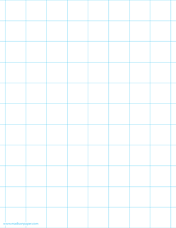





Beech Home Learning
Half Term: Summer 1
Dear parents/carers,
Beech class have returned with enthusiasm to learn! This term we will be exploring significant individuals such as Marie Curie and Ernest Shackleton, writing biographies, and exploring how the river Nile supported the rise of the Ancient Egyptian civilisation.
Kind regards,
Miss Bennett.
Please access My Maths to find three tasks to complete over the half term (equal to one each fortnight). Please ask if you need your login
details. Here is the link:
MyMaths login page
Learn times tables/division facts as often as possible.
Login to TTRS to practise recalling these facts.
https://ttrockstars.com/
Projects
Complete one project​
Have a go at some more if you wish​
Bring to school by
Please aim to read at least 5 times each
week and record this in your reading diary.
Science | Art | PSHE | History
Create your own example of the water cycle with this simple at home experiment. K-2-Experiment-Water-Cycle.pdf | Create your own message using ancient hieroglyphics Facts about hieroglyphics | National Geographic Kids | Write a poem about a person in your life you want to celebrate! | Research and create a fact file about a chosen person from history.

